Slide 1
공통으로 사용할 빈은 root-context.xml
확장자 net을 처리하는 DispatcherServlet 와
확장자 bo를 처리하는 DispatcherServlet 두 개 만들고
각각의 component-scan 영역을 줍니다.
각각의 컨트롤러에서 root-context.xml에서 만든 빈은 모두 접근 가능했지만 스캔영역이 다른 객체를 주입하고자 하면 오류 발생함.

Slide 2
<!-- The definition of the Root Spring Container shared by all Servlets and Filters --> <context-param> <param-name>contextConfigLocation</param-name> <param-value>/WEB-INF/spring/root-context.xml</param-value> </context-param> <!-- Creates the Spring Container shared by all Servlets and Filters --> <listener> <listener-class>org.springframework.web.context.ContextLoaderListener</listener-class> </listener>
<?xml version="1.0" encoding="UTF-8"?> <beans xmlns="http://www.springframework.org/schema/beans" xmlns:xsi="http://www.w3.org/2001/XMLSchema-instance" xsi:schemaLocation="http://www.springframework.org/schema/beans https://www.springframework.org/schema/beans/spring-beans.xsd"> <!-- Root Context: defines shared resources visible to all other web components --> <bean id="common" class="com.naver.myhome.Common"/> </beans>

Slide 3
<servlet> <servlet-name>member</servlet-name> <servlet-class>org.springframework.web.servlet.DispatcherServlet</servlet-class> <init-param> <param-name>contextConfigLocation</param-name> <param-value>/WEB-INF/spring/appServlet/member-context.xml</param-value> </init-param> <load-on-startup>1</load-on-startup> </servlet> <servlet-mapping> <servlet-name>member</servlet-name> <url-pattern>*.net</url-pattern> </servlet-mapping>
<!-- Enables the Spring MVC @Controller programming model --> <annotation-driven /> <!-- Handles HTTP GET requests for /resources/** by efficiently serving up static resources in the ${webappRoot}/resources directory --> <resources mapping="/resources/**" location="/resources/" /> <!-- Resolves views selected for rendering by @Controllers to .jsp resources in the /WEB-INF/views directory --> <beans:bean class="org.springframework.web.servlet.view.InternalResourceViewResolver"> <beans:property name="prefix" value="/WEB-INF/views/" /> <beans:property name="suffix" value=".jsp" /> </beans:bean> <context:component-scan base-package="com.naver.myhome.member" />

Slide 4
<servlet> <servlet-name>board</servlet-name> <servlet-class>org.springframework.web.servlet.DispatcherServlet</servlet-class> <init-param> <param-name>contextConfigLocation</param-name> <param-value>/WEB-INF/spring/appServlet/board-context.xml</param-value> </init-param> <load-on-startup>1</load-on-startup> </servlet> <servlet-mapping> <servlet-name>board</servlet-name> <url-pattern>*.bo</url-pattern> </servlet-mapping>
<annotation-driven /> <!-- Handles HTTP GET requests for /resources/** by efficiently serving up static resources in the ${webappRoot}/resources directory --> <resources mapping="/resources/**" location="/resources/" /> <!-- Resolves views selected for rendering by @Controllers to .jsp resources in the /WEB-INF/views directory --> <beans:bean class="org.springframework.web.servlet.view.InternalResourceViewResolver"> <beans:property name="prefix" value="/WEB-INF/views/" /> <beans:property name="suffix" value=".jsp" /> </beans:bean> <context:component-scan base-package="com.naver.myhome.board" />

Slide 5
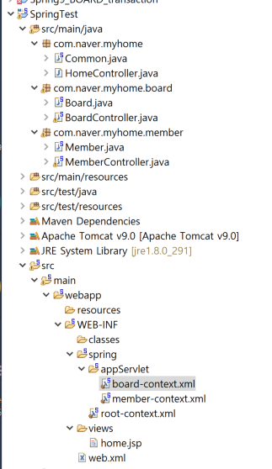
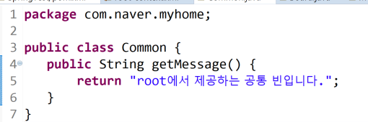
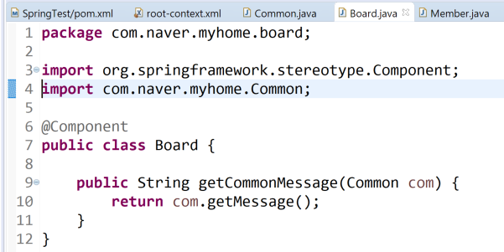

Slide 6
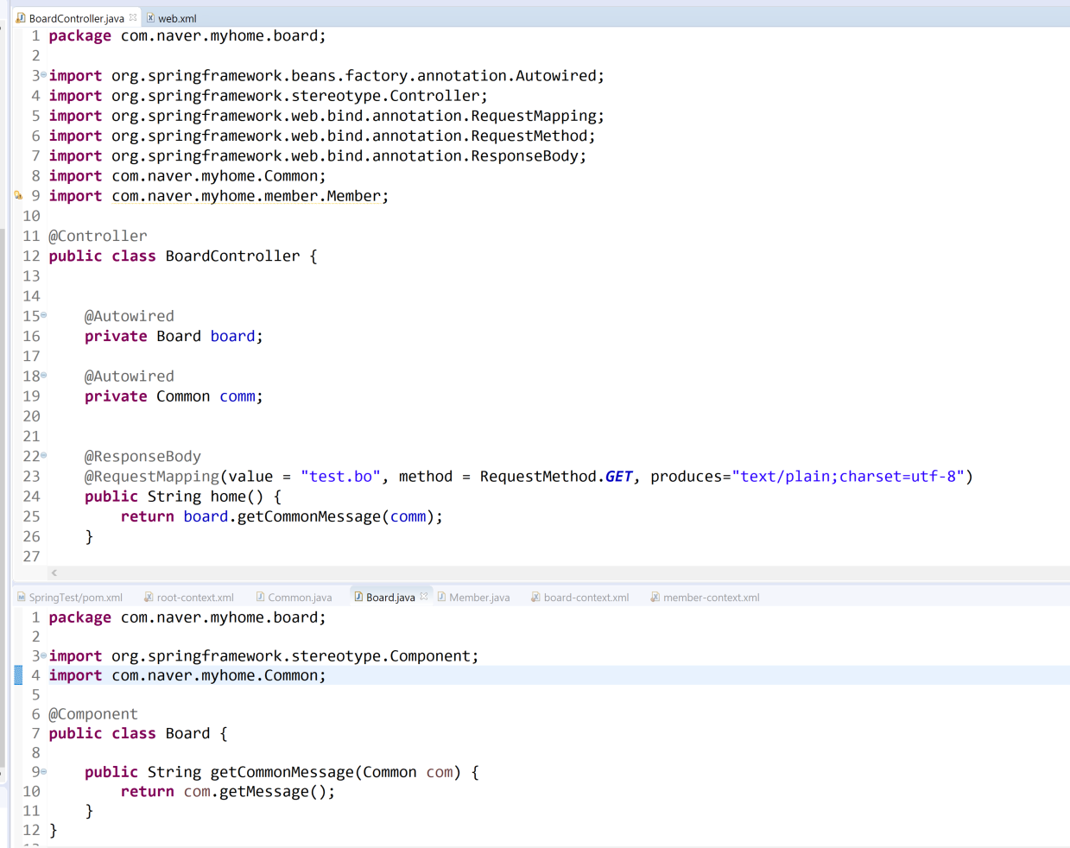

Slide 7
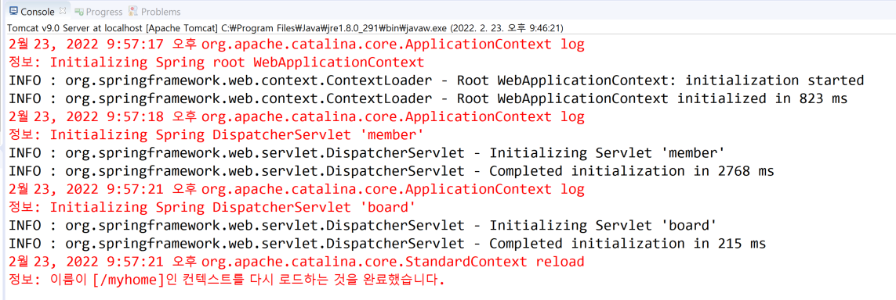
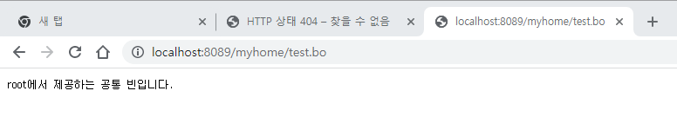

Slide 8
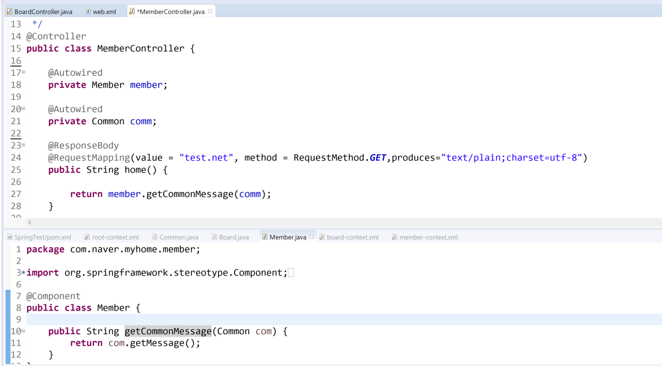
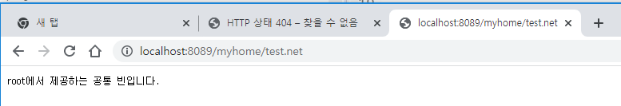

Slide 9
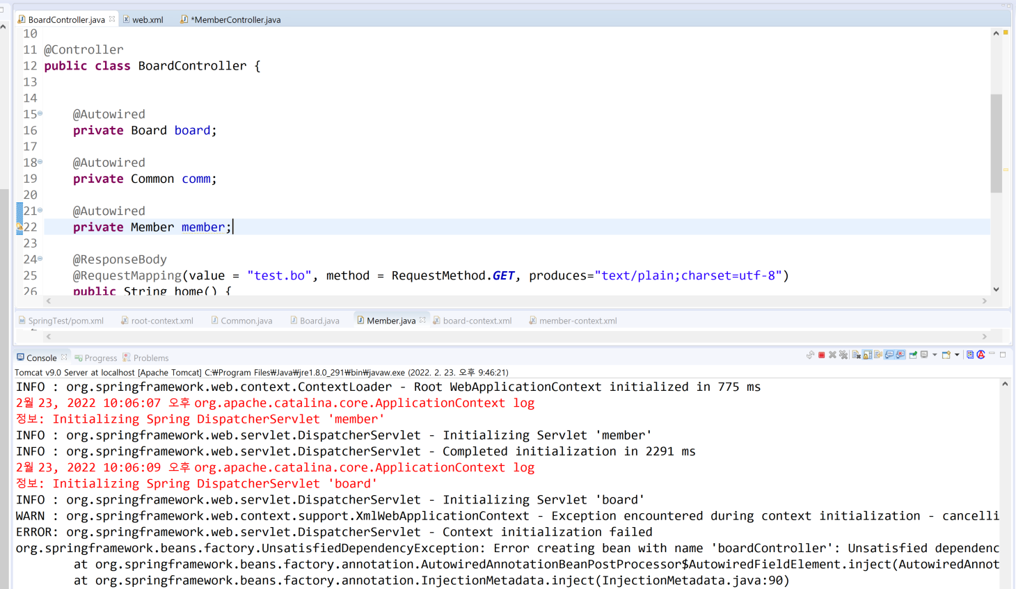
스캔영역이 다른 Member를 주입하고자 선언하면 빈을 찾지 못해 오류 발생합니다.

